Slide 1
Lecture 12 (Chapter 14)
Objectives
Describe the process of convective –diffusive mass transfer over a solid surface in function of the boundary layer
Calculate the mass transfer coefficient h_{m}

Slide 2
Convection-Diffusion over a Surface
Convective mass transfer was calculated as:
Mass
Transfer
Flow
Thermal
boundary layer
Velocity
boundary layer
Boundary Layer
Concentration
boundary layer
Fluid Velocity
Velocity
profile
Concentration
profile
Temperature
profile

Slide 3
Convection-Diffusion over a Surface
Thermal
boundary layer
Velocity
boundary layer
Boundary Layer
Concentration
boundary layer
Fluid Velocity
Velocity
profile
Concentration
profile
Temperature
profile
Thermal Problem (Prandtl Number)
Diffusion Problem (Schmidt Number)

Slide 4
Convective Mass transfer Coefficient
Concentration boundary
layer
y
Diffusive mass flux in
the stagnant fluid
y=0
x
Diffusive mass flux in the fluid =
Convective mass flux =
Diffusive mass flux in the fluid = Convective mass flux

Slide 5
Convective Mass transfer Coefficient
or

Slide 6
Significant Parameters in Convective Mass Transfer
(same analysis than that done on heat transfer)

Slide 7
Significant Parameters in Convective Mass Transfer
Integration over L

Slide 8
Significant Parameters in Convective Mass Transfer
Non-dimensional Gradient
Heat Transfer
Mass Transfer

Slide 9
Heat versus Mass Transfer – same equations are used,
dimensionless number should be changed
Mass Transfer | Heat Transfer
Schmidt Number | Prandtl Number
Sherwood Number | Nusselt Number
Grashof Number | Grashof Number
Rayleigh Number | Rayleigh Number

Slide 10
OBTAINING h_{m} THROUGH ANALOGY WITH HEAT CONVECTIONS
External Convection
For example for Heat Transfer over a flat plate
For example for Mass Transfer over a flat plate
Heat Transfer
Mass Transfer

Slide 11
OBTAINING h_{m} USING AN ANALOGY WITH HEAT CONVECTION
Internal Convection
Assume laminar fully developed flow in a cylinder
Assume turbulent fully developed flow in a cylinder
12/04/2018
11

Slide 12
Natural Convection Mass and Heat Transfer
They are analogous phenomena governed by buoyancy
Mass Transfer: Oxygen from
bubble surface into water
Heat Transfer: Energy from hot
sphere surface into coldest air
Diffusion of O₂ in the
Air inside the bubble
Water flow relative
to bubble
Density
difference
Diffusion of O₂ in the
Air inside the bubble
Density difference is causing
the flow of water over the bubble containing oxygen
Density difference is causing
the flow of air over the heated
sphere

Slide 13
Example of Natural Convection Mass Transfer
Maximum Oxygen Uptake of a Microorganism
Calculate the maximum possible rate of oxygen uptake at 37ºC. The diameter of the microorganism is 1 micron and is suspended in a solution. Assume
that the surrounding liquid is saturated with oxygen. The microorganism is using the oxygen faster that can diffuse it. D_{O2,w} = 3.25x10⁻⁹ m²/s
P_{air}=1atm
T=37ºC
D_{O2,w}=3.25x10⁻⁹ m²/s
c_{O2} = 2.26x10⁻⁴kmol/m³
Assumptions
Concentration of oxygen in surface is zero (it is consumed quickly)
Microorganism density is same solution (assume water)

Slide 14
Example of Natural Convection Mass Transfer
Maximum Oxygen Uptake of a Microorganism
The problem is one of the convective mass transfer over a spherical surface. So let’s
use an equation that is appropriate for that system. Other equations can be found elsewhere in books and articles. For example:
Because the differences in densities is zero

Slide 15
Example of Natural Convection Mass Transfer
Maximum Oxygen Uptake of a Microorganism
The flux of O₂ to the microorganism is given by:
Why is the convective mass transfer non-zero if the fluid velocity is zero?

Slide 16
CONVECTION – DIFFUSION OF HEAT AND MASS TRANSFER
(Simultaneous) – Wet Bulb Thermometer
Energy Balance
Humidity of air
Density of dry air (kg/m³)
Convective mass loss
Convective heat
Wet cloth

Slide 17
CONVECTION – DIFFUSION OF HEAT AND MASS TRANSFER
(Simultaneous) – Wet Bulb Thermometer

Slide 18
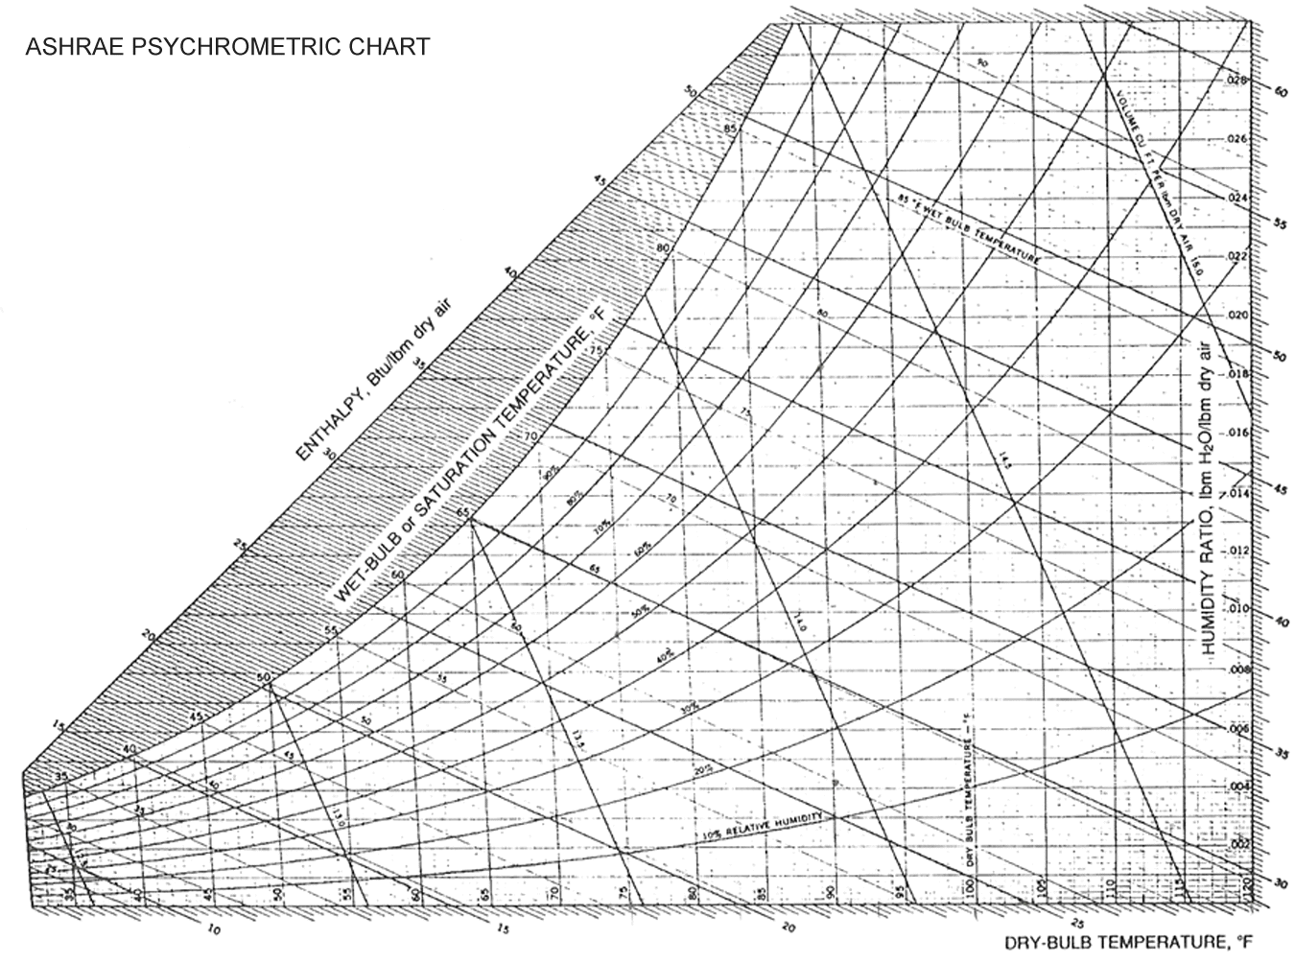
Lines of constant slope

